Slide 1


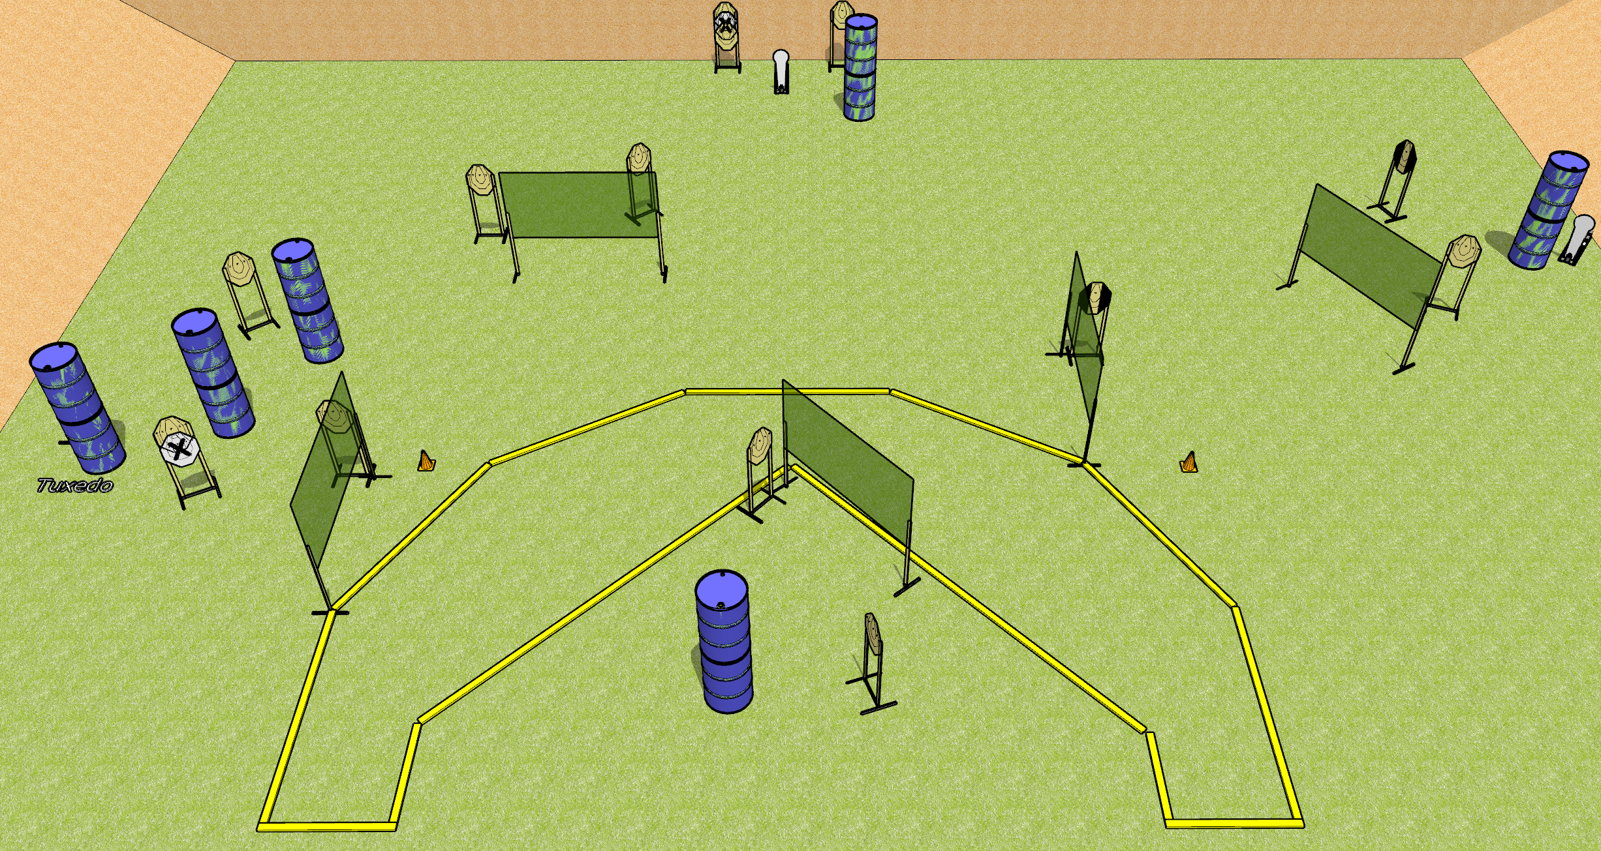
 | Dothan Gun Club – USPSA Match Something or Other Course Designer : Drew Coleman
31 Rounds 15 IPSC targets 1 colt popper
Equipment List 10 wall feet 2 medium fault lines 3 tuxedos

Slide 2
Something or Other
Written Stage Briefing
Something or Other is a 31 round, 155 point, Comstock field course. There are 15 IPSC targets and 1 colt popper. The best 2 hits on paper will score, and steel must fall to score. The start signal is audible.
Handgun start position is heels against either rearmost fault line (circled on diagram), outside the shooting area, facing uprange, wrists above shoulders. Handgun is loaded and holstered.
PCC start position is toes against either rearmost fault line, outside the shooting area. Loaded carbine is held with both hands, shouldered, pointed at either orange cone.
On start signal, engage targets as they become available from within the shooting area.

